Slide 1
Mental Health Prediction using ML
Presented by :Bhumika Jawa

Slide 2
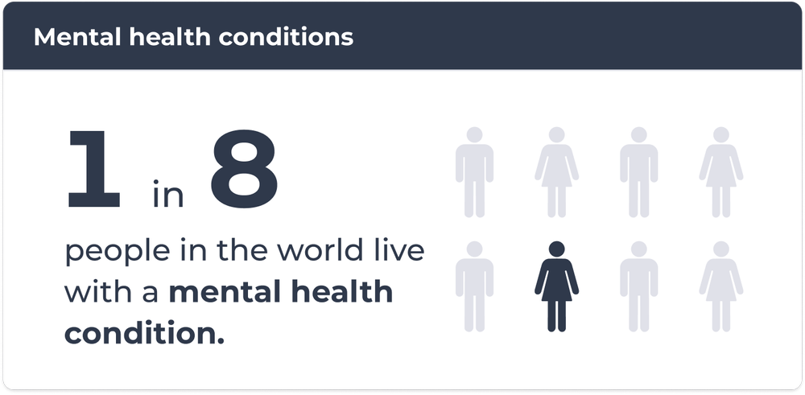
Introduction
According to WHO, a approx 450 million people worldwide suffer from mental health disorder.
Mental health disorders have taken a shape of a
pandemic over the years. So addressing it in a
timely manner is crucial.
As we navigate the complexities of modern life,
mental health challenges are on the rise, making
it important to explore innovative way to address
and predict these issues.
With the advancements in technology have paved the way for revolutionary approaches to mental health, allowing us to predict and intervene before issues escalate.

Slide 3
Aim & Objective
In today’s time it is very common to observe cases of mental health issues. Mental health prediction is one of the most essential parts for reducing the probability of serious mental illness
AIM : The aim of the study is to use data-driven approaches, such as machine learning and deep learning models, to identify patterns in data and to collect valuable insights
OBJECTIVE :
Identify the early signs of mental illness
Better treatment outcomes
Personalized treatment plans
Identifying high-risk patients
More awareness among individuals
Life saving
Lowering the cost of healthcare
Building an ML model than do all these things

Slide 4
Literature Review
In recent years, there has been a rising understanding of the need of early detection and prevention in tackling the complex issues of mental health.
The field of mental health has emerged over the years, with use of these developments in the technology healthcare and data science can collaborate together to identify early signs or identifying in risk patients ad improve treatment methods.
How machine learning will help in mental Health prediction ?
Dataset
Demographics data
Clinical History
Behavioral Data
Psychosocial Stressors:
Self-Reported Information
Environmental Factors
Daily Life Functioning
Geographic Data
Age
Gender
Ethnicity
Socioeconomic status
Education level
Previous mental health diagnoses
Family history of mental health disorders
History of medication and treatment
Sleep patterns
Physical activity
Substance use (alcohol, drugs, etc.)
Dietary habits
Relationship status
Financial stressors
Self-reported stress levels
Quality of life assessments
Living conditions
Workplace environment
Social support networks
Employment status and satisfaction
Daily routines and habits
Location

Slide 5
Studies done
Research Paper Title | Year | Methodology | Research Gap
Prediction of mental health treatment adherence using ML algorithms | 2023 | In this research paper, they have worked on various ML algo’s to build a predictive model & the evaluated the model using accuracy & precision | There are many limitations on this study. The generalizability of the model may be impacted by intrinsic biases in the dataset. Predictions may be impacted by missing numbers and poor data quality.
Machine Learning for Mental Health Prediction in Social Media Data | 2022 | This study used natural language processing (NLP) techniques to analyze social media posts and applied machine learning algorithms for mental health prediction. | Social media postings including biased data, mental health labels without objective information, and user privacy ethics raised.
Machine Learning Techniques for Prediction of Mental Health | 2021 | This paper provides a comprehensive review of various machine learning techniques and their applications in mental health prediction. | No original data collection or experimentation, potential bias in selected studies.
A Survey on Wearable Sensors for Mental Health Monitoring | 2023 | Wearable sensors were employed to track behavioural and physiological data, and machine learning techniques were utilised to forecast mental health. | Limited long-term data collection, potential discomfort or users wearing sensors.
Prediction of Public Mental Health by using Ml Algorithms | 2022 | This paper involves a very retrospective approach, having data of individuals with different mental health records and performed pre-processing and data analysis steps. Using basic pre build machine learning algorithms and tested for predictions. Performance was evaluated using different metrics like accuracy & F1 score. | The study is limited because it is completely dependent on electronic health records and the data is collected from very small population. There is a lack of long term follow up which is constraint for early prediction.

Slide 6
Process:
Start
Data Selection
Data Preprocessing
Data Visualization
Feature Scaling
Missing value treatment
Univariate
Feature elimination
Train – Test Split
Bivariate
Logistic Regression
Multi- Variate
K- Nearest Neighbor
Model Development
Train Data
Test Data
Decision Tree
Random Forest
Bagging
Accuracy
Model Evaluation
Precision
Boosting
AUC
Stacking
Sensitivity
End
Specificity

Slide 7
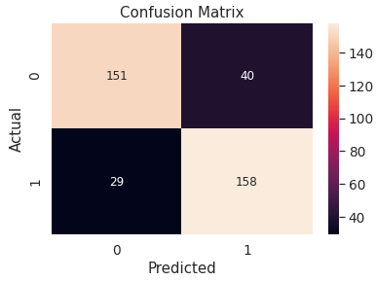
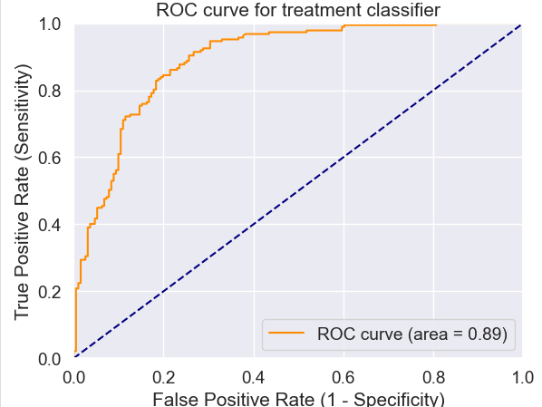
Final Model
KNN
Input data
Random Forest
Logistic Regression
Output
Gaussian NB
{
{
Level 1
Level 2
Evaluation Metrics:
Accuracy: 82.01%
Precision: 79.30%
AUC: 89%
Sensitivity: 86.09%
Specificity: 78.01%

Slide 8
Other Models:
Logistic Regression
Precision: 76.40%
K nearest neighbor
Precision: 75.10%
Decision Trees
Precision: 74.10%
Sensitivity: 85%
Sensitivity: 90.30%
Sensitivity: 93.50%
Accuracy: 79.60%
Accuracy: 80.40%
Accuracy: 80.60%
Random Forest
Precision: 75%
Bagging
Precision: 78.50%
Boosting
Precision: 76.10%
Sensitivity: 93.04%
Sensitivity: 82.89%
Sensitivity: 91.90%
Accuracy: 81.20%
Accuracy: 77.70%
Accuracy: 81.70%

Slide 9
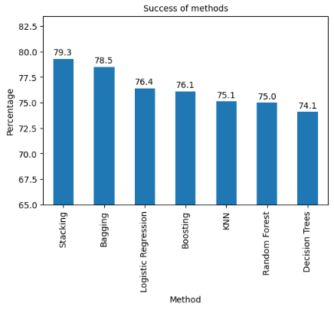
Comparison:
We are considering precision as the final metric because :
Our focus is on reducing the number of false positives.
Precision would be important if the goal is to ensure that individuals identified as at risk truly require intervention, minimizing unnecessary interventions
In applications with healthcare considerations, where false positive predictions might have serious consequences, precision is a suitable metric.

Slide 10
Conclusion
Learning:
Hands on and better understanding of ensemble models especially stacking.
Great knowledge add on by understanding more about mental health issues and symptoms
Parameters used in the model , be it cross validation or finding the right number of neighbors etc.
Contribution:
Creating a new model by using a combination of pre trained models that give quite better results than individual pre trained models.
Comparison of results with graphs and decide the best model with great results.

Slide 11
Conclusion
Limitations:
Models developed on one population may not generalize well to other populations, especially if there are cultural or demographic differences.
Datasets may be noisy or incomplete due to inconsistencies in self-reported information
People might not feel comfortable in providing the information because of society.
Future Work:
Further improve the precision and effectiveness of model.
Data from social media can be fetched for better understanding.
Data from various electronic devices can be collected for better insights.

Slide 12
Thank You

